Slide 1

UE20CS390A – Capstone Project Phase – 1
Project Progress Review #2
(Project Requirements Specification and Literature Survey)
Project Title : Voice Interface for PESU using AI
Project ID : PW23_PB_01
Project Guide : Prof. Priya Badrinath
Project Team with SRN : 805_806_826_844

Slide 2
Title of the Project
Abstract
Our Project Basically Aims to Provide Voice Interface for PESU Website. Whether it’s asking about ISA’s, Timetables, Results etc. Just Ask. And
Besides PESU Website it can Also be your General Voice Assistant. To help you remember everything and notify deadlines prior

Slide 3
Title of the Project
Suggestions from Review - 1
Some of Panel members pointed out really important thing ”How are you gonna fetch ISA Timetable. It’s in pdf format”. Although we did’nt have answer for that then
We do have now We’re gonna use Opencv for extraction of table information from ISA and any PDF into CSV (Refered from this Table Detection and Extraction using OpenCV and Novel Optimization Method paper)

Slide 4
Title of the Project
Constraints / Dependencies / Assumptions / Risks
Describe the issues such as legal implications, usage limitations, specific software/hardware requirements etc under dependencies.
Describe the assumptions made in your project/problem statement.
Talk about the risks that could pose obstacle to your final project delivery(technology failure or hardware failure threats or version compatibility problems).

Slide 5
Title of the Project
Constraints / Dependencies / Assumptions / Risks
Assumptions made
PESU will allow us to scrape Their Website.
This is only limited to Students only
Risk involved
Our only risk is of leakage of confidential data of students. We need Max Security for this
Usage Limitations
Only applicable to Students for now. (May Extend to Professors also. Depends on work and feedback)

Slide 6
Title of the Project
Functional Requirements
Functions Actions/Operations Performed are
Voice Authorization
Generating Intents and Arguments
Then sending Arguments to database
Caching most asked Queries
NLP module for extracting intents and arguments

Slide 7
Title of the Project
Non - Functional Requirements
Non-functional Requirements Would be
Security for student Data
It must be easy to use
Must Be Accurate with the information it provides
And Must authorize Correct user

Slide 8
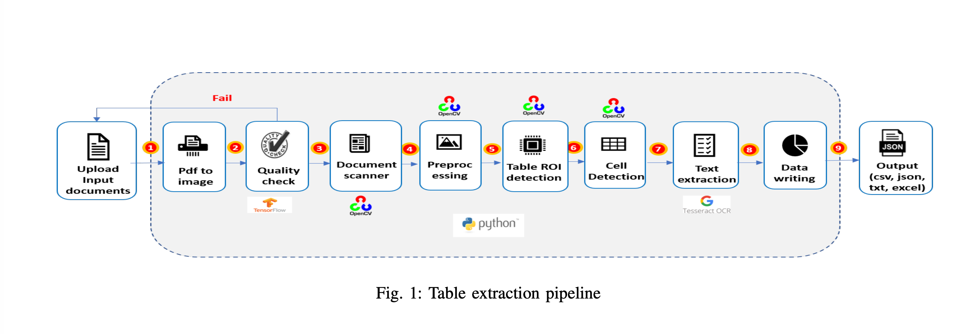
Title of the Project
Literature Survey
Table Detection and Extraction using OpenCV and Novel Optimization Methods
This Solves our issue of table extraction by using OpenCV.

Slide 9
Title of the Project
As You can see in image You need to upload documents.
Trained model will Check for its quality. After converting It from pdf to image
Then document scanner Will scan the document pre-process the image
Literature Survey

Slide 10
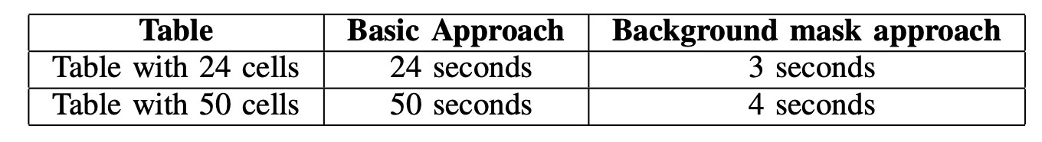
Title of the Project
Literature Survey
Then Cells are detected and text are extracted and csv/json/txt/excel is generated
Logistic regression is used for quality checks
Performance Is optimized by creating background mask is created by calculating the size of height and width from all the cell ROI crops

Slide 11
Title of the Project
Opencv is used for perform Warp perspective, cell detection, preprocessing etc
Literature Survey

Slide 12
Title of the Project
A Method for Voice Activity Detection using K-Means Clustering
Literature Survey
Mel-Frequency Cepstral Coefficients
This provides a distribution which is very similar to human voice
Spectral Roll – Off
Spectral Centroid
By using this feature our weighted model will contain a segment with high values for noise and low values for human voice. Hence, this should result in better clustering capability of our machine learning model.
Zero Crossing Rate
Zero Crossing Rate is the measure of the number of times a given signal changes its sign in a time frame.

Slide 13
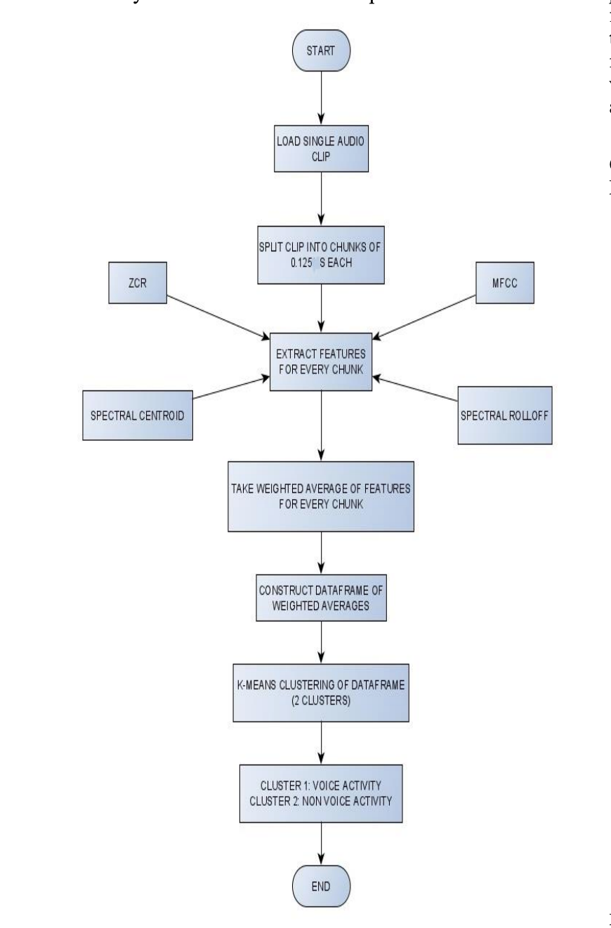
Title of the Project
Working model is simple, audio is broken down into .125 seconds clip, fed to feature extraction algorithm
Then, weights are added and passed to KNN, KNN classifies as human voice and non Human voice
Literature Survey

Slide 14
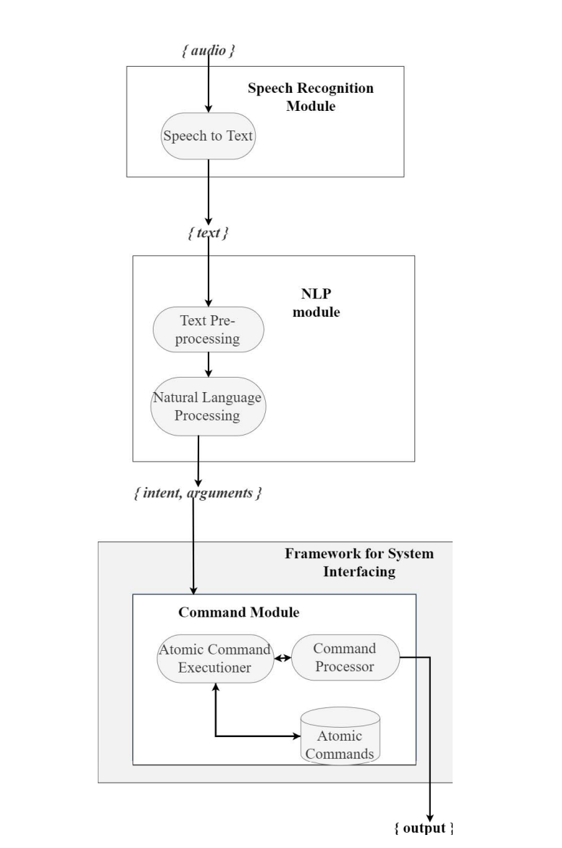
Title of the Project
Literature Survey
This paper aims at generating intents and arguments
As shown in the image, text is given as input to the STT module
NLP module generates intents and arguments
Then pass to command Module, where the actions/operations are performed
A Framework for System Interfacing of Voice User Interface for Personal Computers

Slide 15
Title of the Project
Literature Survey
The SpeechRecognizer library can be used in 2 variants.
Online and offline modes, only difference is in online mode audio is passed to Certain Api’s
On the other hand, offline mode makes use of the popular ’CMU Sphinx’ library for conversion of speech to text.

Slide 16
Title of the Project
Literature Survey
Web Scraping Approaches and their Performance on Modern Websites
Most important way to get data for our project is from Websites,
In which we have the following techniques
Techniques for web Scraping
Basic requests library tests:
Requests library with header:
Basic selenium test:
Headless selenium test with window-size argument
External library test

Slide 17
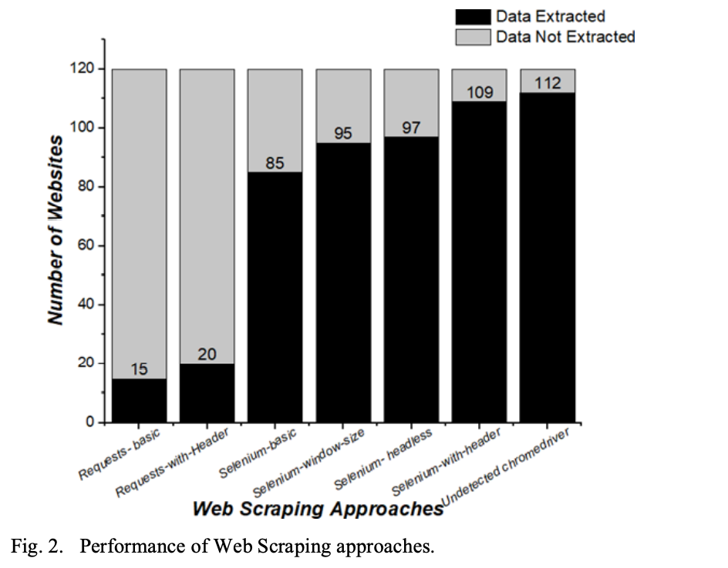
Title of the Project
As you can see, Undetected Selenium, performs the best
Because most website have Active bots that check where the request made from User or web scraping bot
Literature Survey

Slide 18
Title of the Project
Literature Survey
Artificial intelligence based Voice assistant
This paper goes in depth about how to get audio from user and process it with Acoustic Analysis
Acoustic Modelling - it represents that the elements were pronounced or not and what are the words which can complete these elements.
Pronunciation Modelling: That analyses the way, where how these elements are pronounced, it will check whether there is any accent or other peculiarities.
Language Modelling: This is often aimed toward finding contextual probabilities counting on what elements were captured.

Slide 19
Title of the Project
Literature Survey

Slide 20
Title of the Project
Literature Survey

Slide 21
Title of the Project
Literature Survey

Slide 22
Title of the Project
Summary of Literature Survey
Models specified in these papers are having Accuracy rate of more than 94%
According to the survey, We may be able to increase performance, due to the fact that there will be less noise compare to what they’re using
And for the pdf to csv conversion we may have to implement our own algorithm for enhanced preprocessing, because our pdf are slightly inclined due to little stutter, while capturing the document using phone camera

Slide 23
Title of the Project
References
Artificial_Intelligence-based_Voice_Assistant - Subhash S, Ullas A, Santhosh B, Siddesh S
A Framework for System Interfacing of Voice User Interface for Personal Computers Preet Dabre, Rohit Gonsalves, Raj Chandvaniya, and Anant V. Nimkar Department of Computer Engineering Sardar Patel Institute of Technology Mumbai, India
Table Detection and Extraction using OpenCV and Novel Optimization Methods – Nidhi, Karandeep Saluja, Asmita Mahajan, Akash Jadhav, Nakul Aggarwal
Web Scraping Approaches and their Performance on Modern Websites - Ajay Sudhir Bale, Naveen Ghorpade, Rohith S, S Kamales
A Method for Voice Activity Detection using K-Means Clustering - Atul Rohit Agarwal, Sourabh Tiwari, Sudhakar M S, Sankar Ganesh S

Slide 24
Title of the Project
Thank You

